Slide 1
FF Thumbnail strategy
7.29.24
Data used: link

Slide 2






History of FF thumbnails

Slide 3
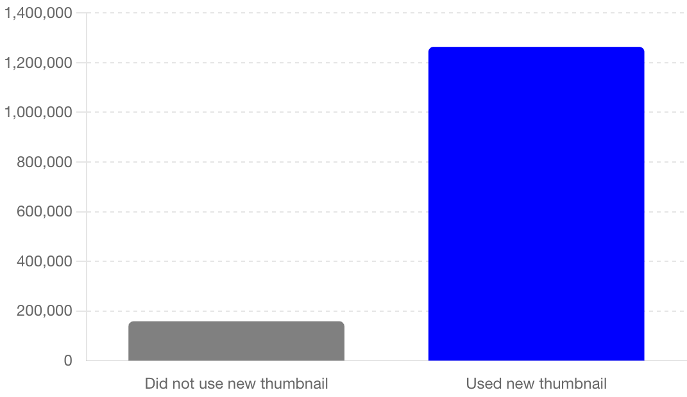
FF thumbnail comparison (All episodes of season 3&4 used in all charts)

Slide 4
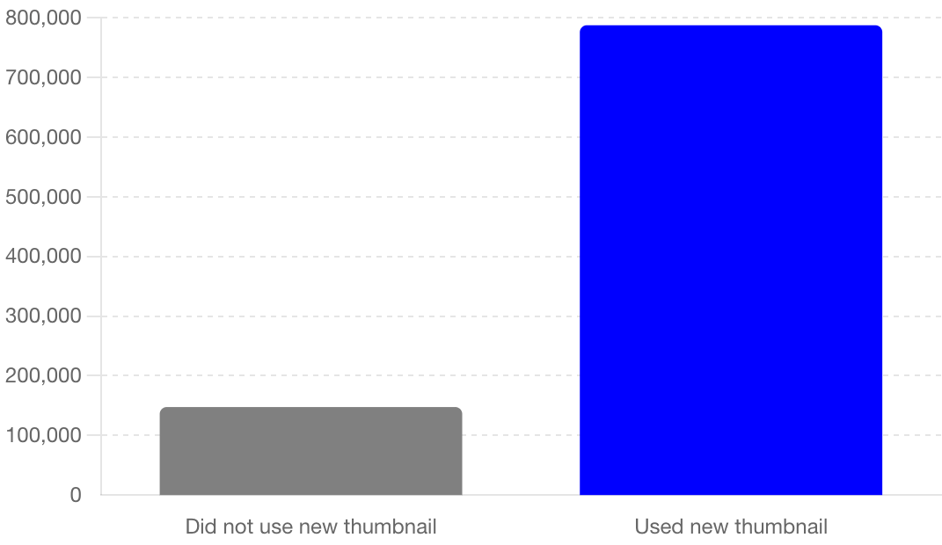
FF thumbnail comparison (removing top outlier from both)

Slide 5









Competition

Slide 6
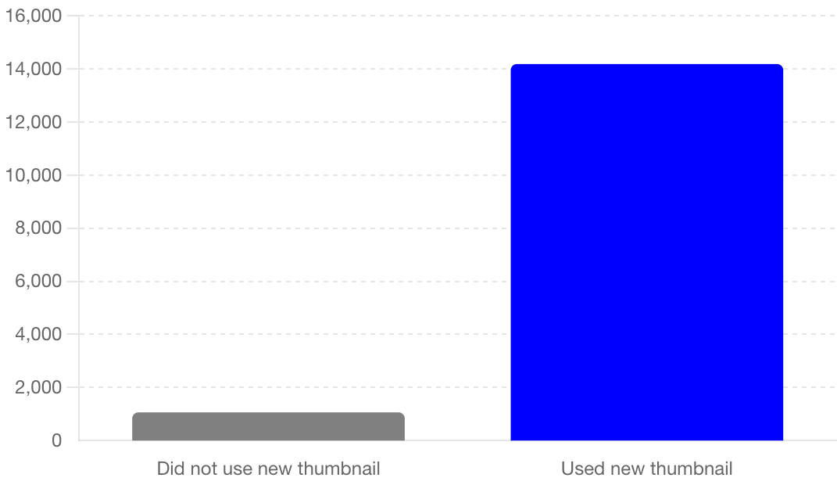
FF Thumbnail subscribers gained

Slide 7
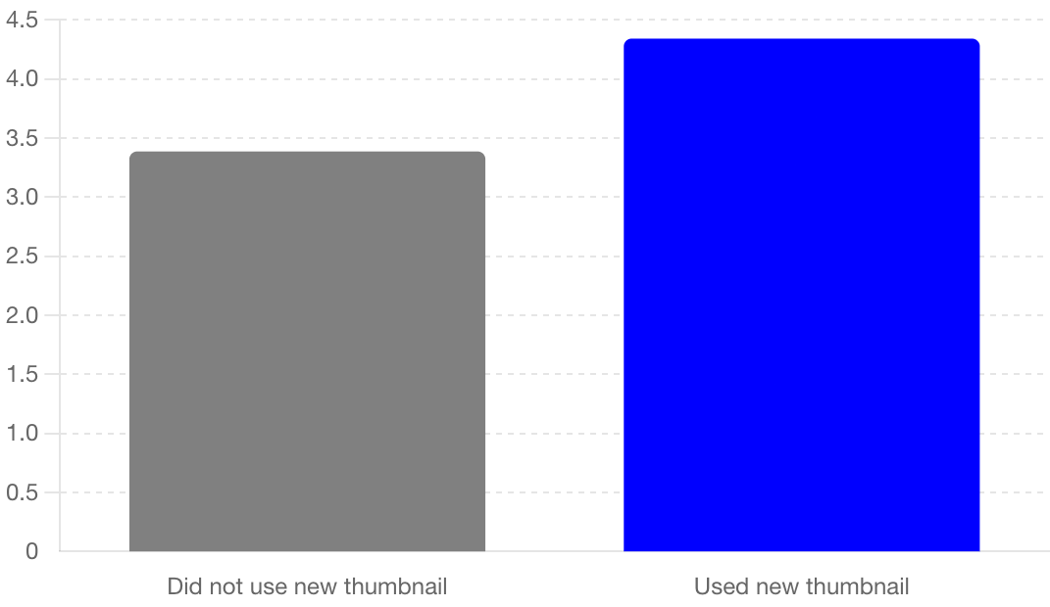
FF thumbnail CTR %

Slide 8
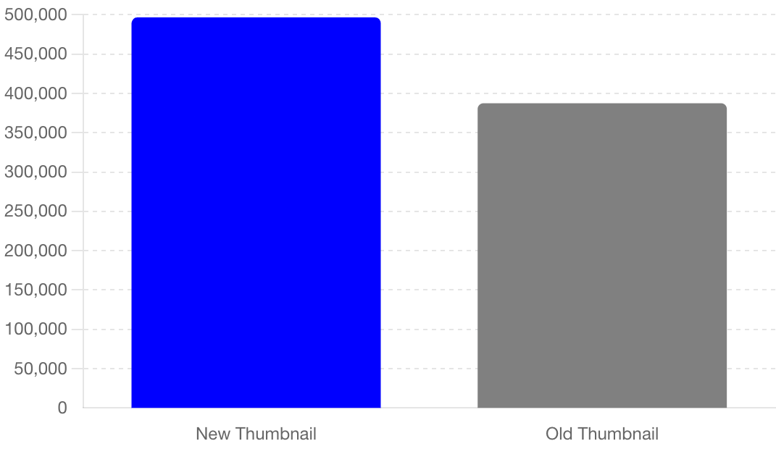
FF Average impressions on all FF episodes: 11,440,538
109,293 views

Slide 9
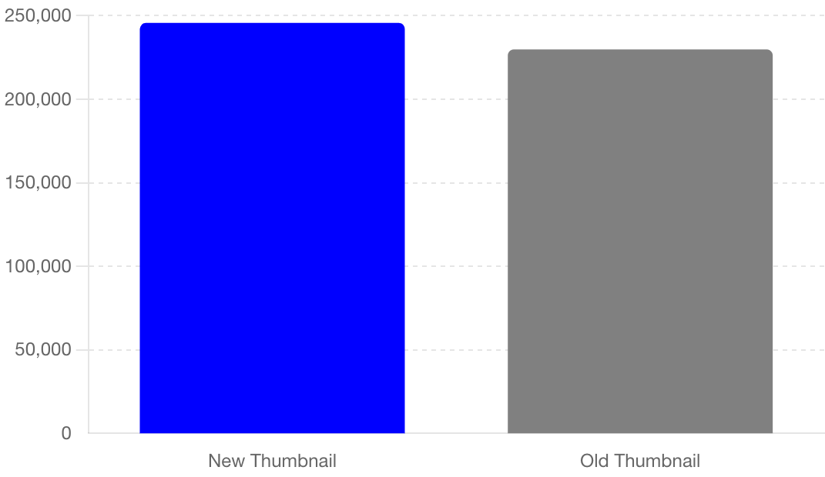
FF thumbnail total revenue
19
33

Slide 10
FF revenue
On average, the revenue per video is:
Videos using the new thumbnail: $12,932.04
Videos not using the new thumbnail: $6,963.58
This means that, on average, videos using the new thumbnail generate approximately $5,968.46 more revenue per video compared to those not using the new thumbnail.

Slide 11
Video 1 Growth Rate: The exponential growth rate from "What Katt Williams DIDN’T Say, The UNDISPUTED Breakup..." was calculated to be 0.061.
Video 2 Growth Rate: The exponential growth rate from the second video was calculated to be 0.0278.
Target Video Initial Data: The initial views for "OnlyFans Millions, Reality TV Scars, Marriage, Dating & Being Bisexual | Erica Mena Funky Friday" were 450,337.
Estimated Views (Lower): Using the growth rate from Video 2, the target video could have reached approximately 980,410 views.
Estimated Views (Upper): Using the growth rate from Video 1, the target video could have reached approximately 2,485,260 views.

Slide 12
FF thumbnail overall
The new thumbnail strategy led to significantly higher average views.
The new thumbnail strategy resulted in a substantial increase in subscribers.
The new thumbnail strategy almost doubled the watch time.
Although videos without the new thumbnail had higher impressions, the new thumbnails resulted in better engagement (CTR).
The new thumbnail strategy increased the click-through rate, making viewers more likely to click on the videos.
The new thumbnail strategy generated approximately $15,910.73 more total revenue.
On average, videos using the new thumbnail generated approximately $5,968.46 more revenue per video.

